Slide 1

NativeScript
Cross-platform mobile apps with JavaScript
Notes:
NATIVESCRIPT: CROSS-PLATFORM NATIVE MOBILE APPS WITH ANGULAR
Do you want to build native mobile apps for iOS and Android? Are you a web developer? Then NativeScript is the perfect framework for you. NativeScript is an open source framework for creating native mobile apps using the skills of the web developer: JavaScript, CSS and simple tag-based markup. Create rich, high-performance iOS and Android apps with 100% native UI using many of the skills you already have. In this full-day workshop, you will gain all of the skills you need to immediately begin creating cross-platform native apps using the free and open source NativeScript framework.
Topics covered include:
NativeScript framework core concepts and getting started
Accessing native device capabilities with JavaScript
Building native mobile apps with Angular 2
Common app patterns (login, settings, data bound list and more)
Styling NativeScript with CSS
Targeting specific devices and screens
Debugging and deploying to devices
There has never been a better (and easier) way for web developers to create native mobile apps. Impress your co-workers, clients and boss by joining this workshop and becoming a cross-platform mobile app developer in a day!

Slide 2

Todd Anglin
Burke Holland
@toddanglin
@burkeholland

Slide 3
Workshop Agenda
Ante Meridiem (9AM to Noon)
Post Meridiem (1PM to 4PM)
Intro to NativeScript
NativeScript core concepts
“Hello World”
Defining Views
Basic data binding
Styling views with CSS
Extending with plugins
Debugging JavaScript
TypeScript, App Patterns and Angular
Navigating views
Adding animations

Slide 4
Intro to NativeScript
”How did we get here?”

Slide 5
Early prototypes
“Core” engineering
Public launch
Adoption ramp-up
Mass adoption
2013
2014
2015
2016
2017
Project Timeline

Slide 6
Delivering on the overdue promise of “hybrid.”

Slide 7





Swift/Obj-C
Java
.NET

Slide 8
Hybrid Promise
100% Web
Hybrid
100% Native
Reach
Code/Skill Reuse
Richness
Premium experience
Device APIs
Best of both?

Slide 9
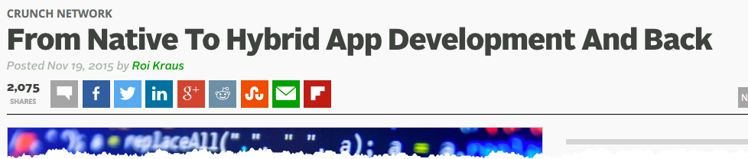
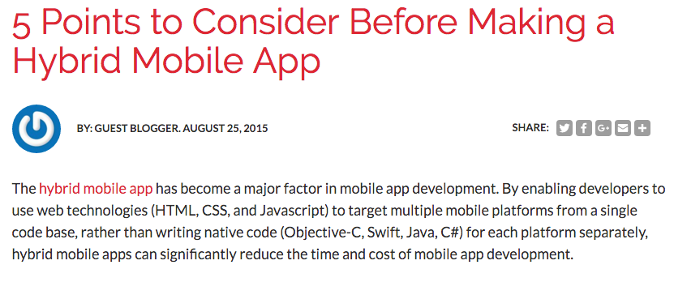
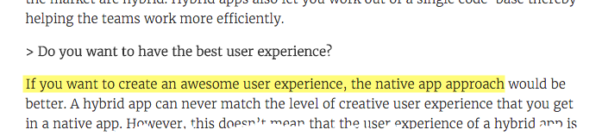
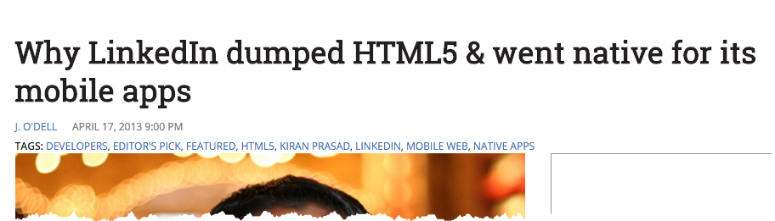
Hybrid Reality
Notes:
Quote source: http://julyrapid.com/hybrid-vs-native-mobile-app-decide-5-minutes/

Slide 10
Hybrid Reality
The first 80% of the code accounts for the first 80% of the dev time.
The remaining 20% of the code accounts for the other 80% of the dev time.
Notes:
Quote source: http://julyrapid.com/hybrid-vs-native-mobile-app-decide-5-minutes/

Slide 11
Hybrid Reality
Performance bottlenecked by mobile web views

Slide 12
Hybrid Promise
100% Web
Hybrid
100% Native
Reach
Code/Skill Reuse
Richness
Premium experience
Device APIs
Compromises

Slide 13
Hybrid Reality
“Web”
Hybrid
100% Native
Fast to market
Best experience

Slide 14
Hybrid Reality
“Web”
Hybrid
100% Native
Fast to market
Best experience

Slide 15
Hybrid Reality
“Web”
Hybrid
100% Native
Fast to market
Share code
Reuse existing skills/teams
Reuse existing libraries
Best experience
Native UI (no WebView!)
Full access to device APIs
Immediate access to new OS features

Slide 16

“Native Hybrid”
Fast to market
Share code
Reuse existing skills/teams
Reuse existing libraries
Best experience
Native UI (no WebView!)
Full access to device APIs
Immediate access to new OS features

Slide 17

What is NativeScript?
Open source framework (ASLv2)
Create native mobile apps for iOS, Android (and eventually Windows 10)
Use JavaScript (“web skills”)
Write once, run everywhere
Share 100% code between iOS/Android
Share 80% code with web
Reuse popular plugins from NodeJS/iOS/Android
Integrates deeply with Angular and TypeScript

Slide 18
With NativeScript…
No web views (platform native UI)
Use JavaScript (or TypeScript)
100% access to ALL native APIs (even new APIs)
Made for “web developers” (JS, CSS, XML)
Use Angular for web AND native mobile
Reuse thousands of libraries from Node/iOS/Android/Web

Slide 20





“Cross-compile”
“Native Hybrid”
“Web Hybrid”
+
Xamarin
(owned by Microsoft)
React Native
(owned by Facebook)
Fuse Tools
(beta)
Ionic
(+ PhoneGap)

Slide 21

Cross-Platform Landscape
Advantages
Ionic (open source, independent)
Working on Angular 2 version of product
Continuing to go long on hybrid/web
React Native (open source, Facebook)
Compliments ReactJS (web) adoption
Fuse Tools (open source*, independent)
Still in “private beta”
Focusing more on designers (tools to convert PhotoShop => mobile app)
Xamarin (open source*, Microsoft)
MSFT acquired in March 2016
Popular option for C# developers
Native performance, no “web view” compromises
Aligned with Angular community, better cross-platform story, No “Parse fears”
Developer focused, Angular community, Platform native UI
Angular community, better shared codebase story, web dev focus

Slide 22
The {N} difference…

Slide 23
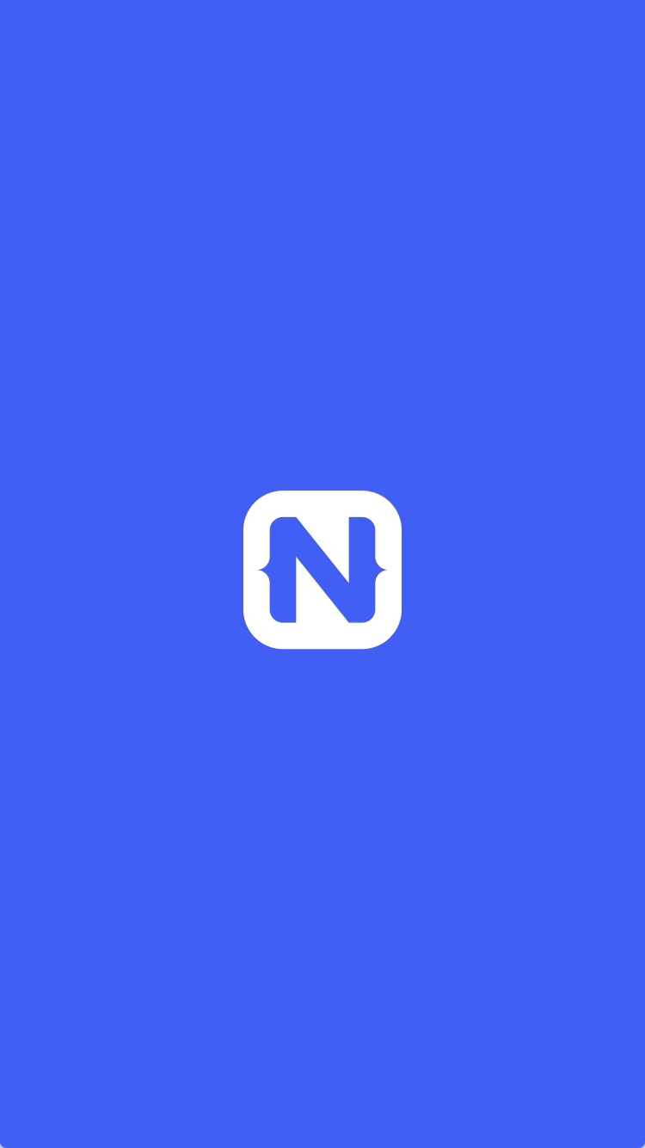
1
Rich, animated, “no compromise” native UI
(with shared UI code)
Demo available in the app stores in May

Slide 24
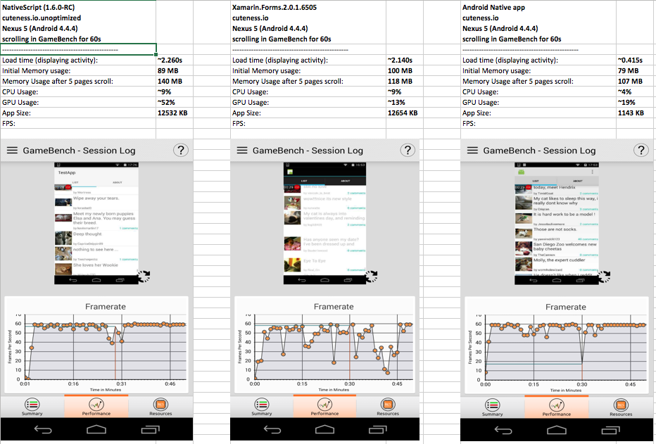



2
Measurable native UI performance
(“no jank”)

Slide 25
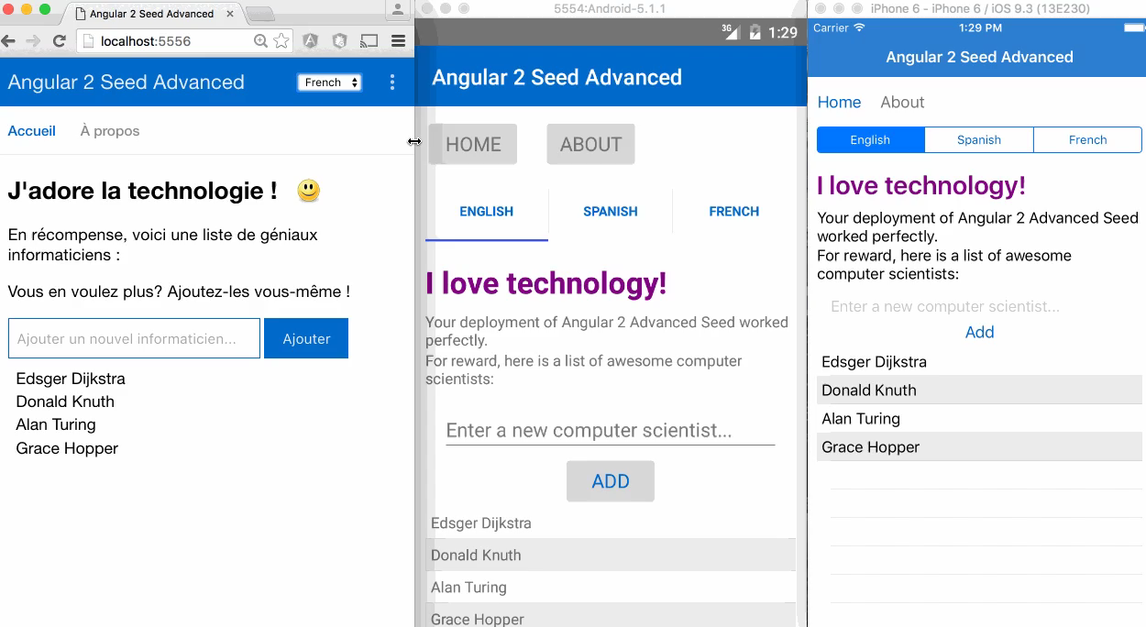
3
Maximum code and skill reusability
Video credit: Nathan Walker, {N} community member

Slide 26
How does NativeScript work?
Under the covers

Slide 27


Slide 28
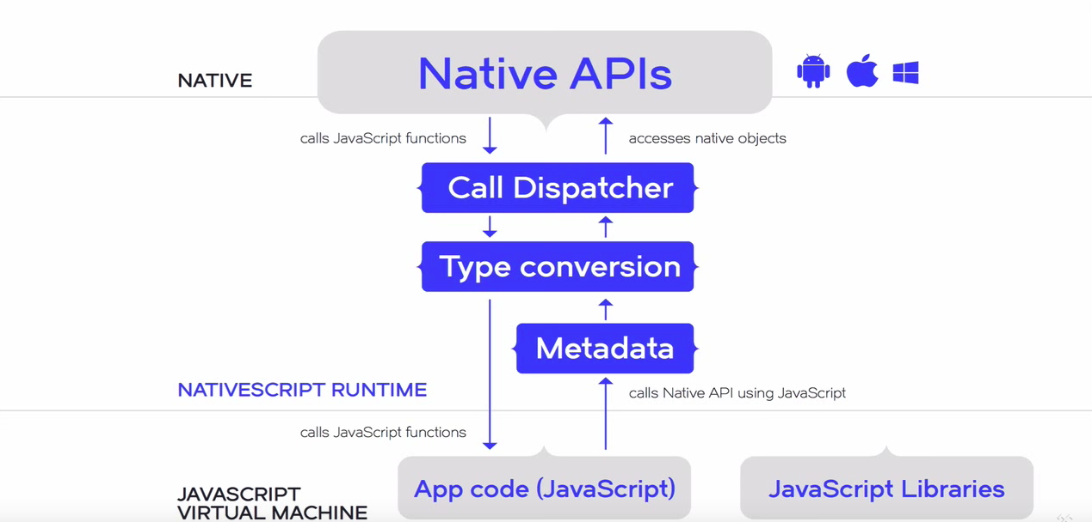
Generated at build time for OS & 3rd party native libraries

Slide 29
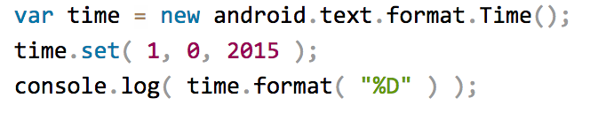
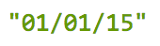
NativeScript Android example
output:
JavaScript
Notes:
I'll give your brain a minute or two to parse this, because yes, this JavaScript code instantiates a Java android.text.format.Time() object, calls its set() method, then logs the return value of its format() method, which is the string "01/01/15".

Slide 30
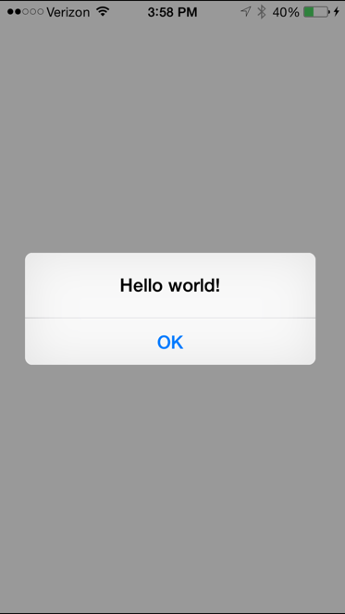
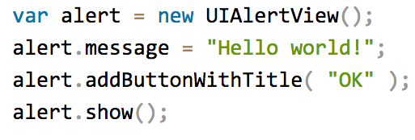
NativeScript iOS example
JavaScript
Notes:
This JavaScript code instantiates an Objective-C UIAlertView class, sets its message property, and then calls its addButtonWithTitle() and show() methods. When you run a NativeScript iOS app with this code you'll see the alert below:

Slide 31
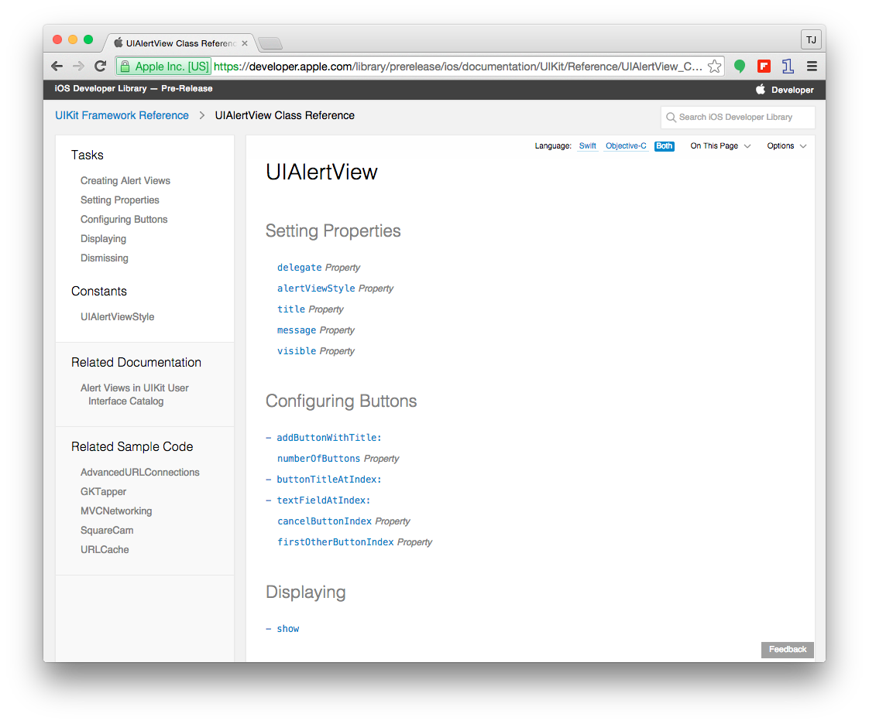

Slide 32
Runs on V8 JavaScript VM
Runs on JavaScriptCore VM

Slide 33
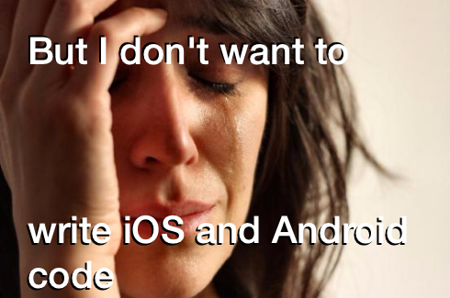

Slide 34
NativeScript Module Layer (NML)
Abstractions on native APIs that provide unified, cross-platform API
Dozens available out of the box
Easy for developers to add
IMPORTANT: All native APIs still available at JavaScript layer for platform-specific scenarios
NativeScript modules follow Node module’s conventions (CommonJS).

Slide 35
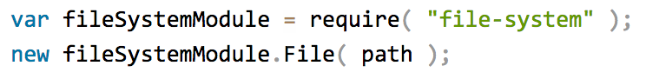

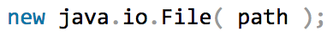

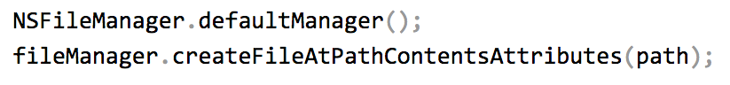
Example: NativeScript file module

Slide 37

BUT HOW DO I TURN THIS INTO AN APP?

Slide 38
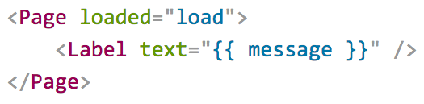
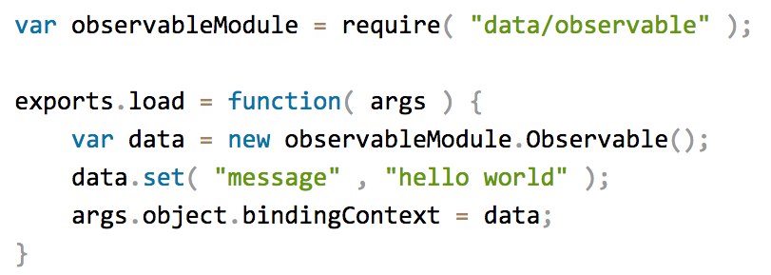
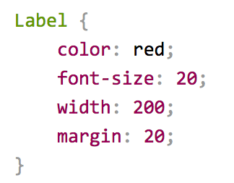
Putting it all together
Define UI with XML
Logic with JavaScript
Style with CSS

Slide 39
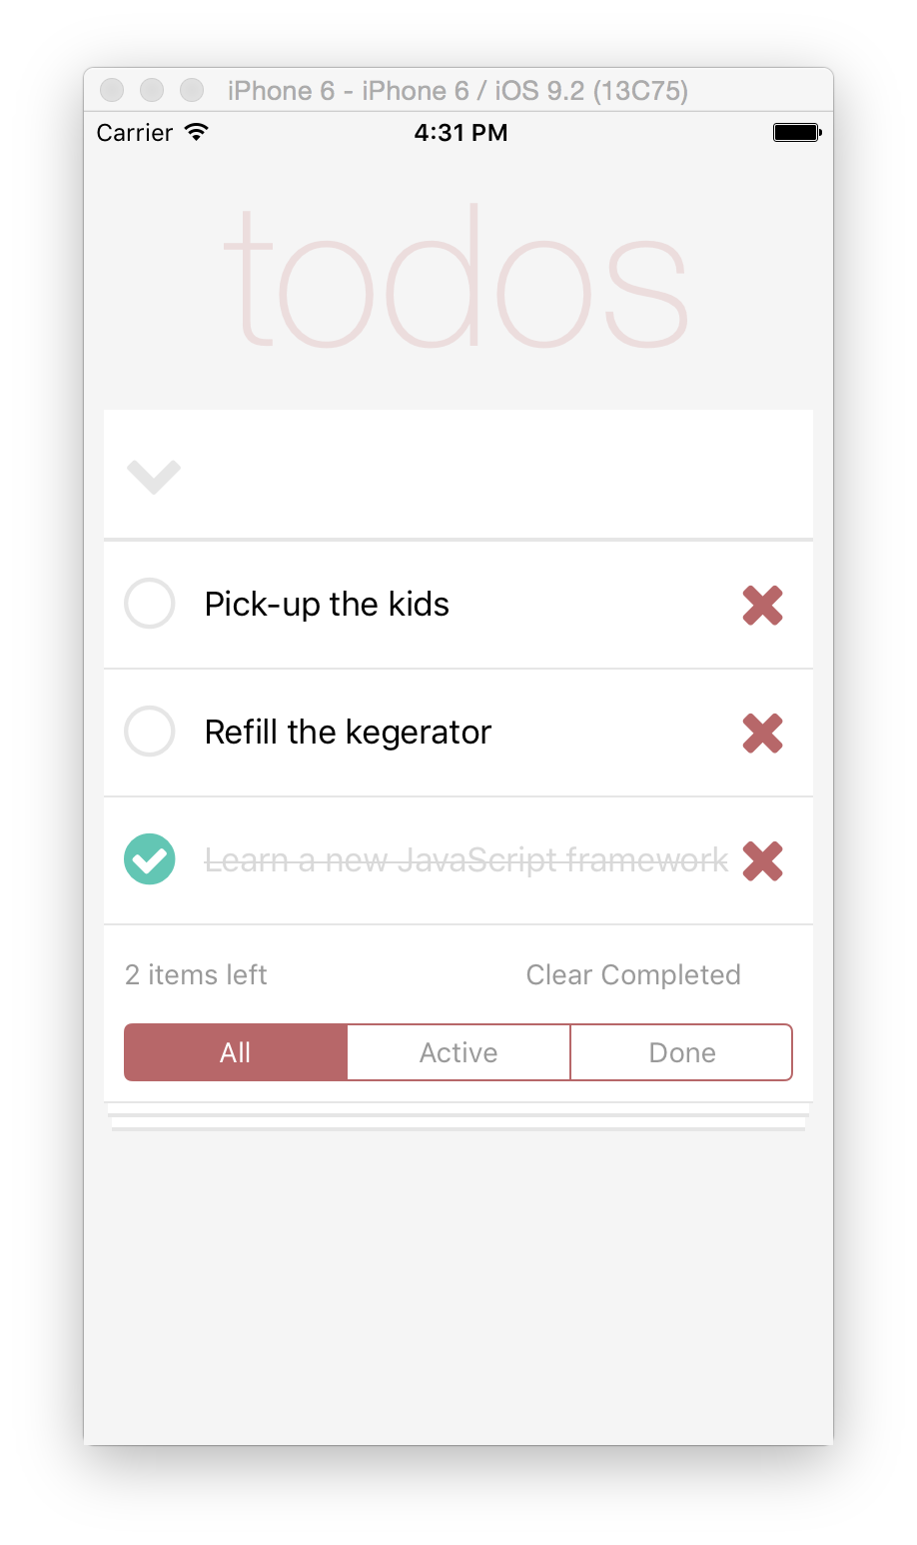

Slide 40
“Hello World”

Slide 41

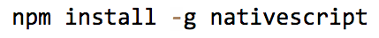
Two ways to use NativeScript
1)
2)

Slide 42
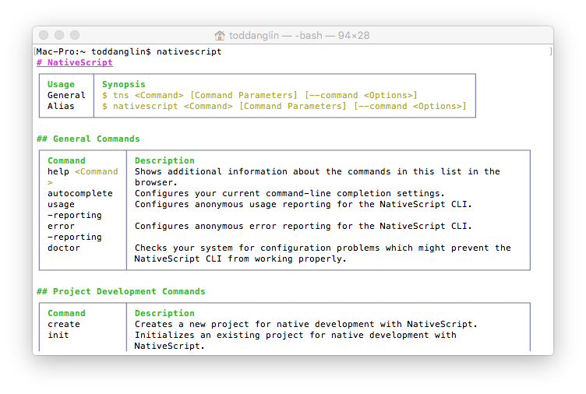
Command Line Interface (CLI)
Use Command Prompt (Win) or Terminal (Mac, Linux)
Free, Part of open source project
Requires installation, local environment setup to build for iOS/Android (requires Mac for iOS)
Integrates with Visual Studio Code (via plugin)
WHY: More control, Free, Integrate with existing IDEs/code editors
WHO: More technical developers used to using CLI, Open source developers

Slide 43
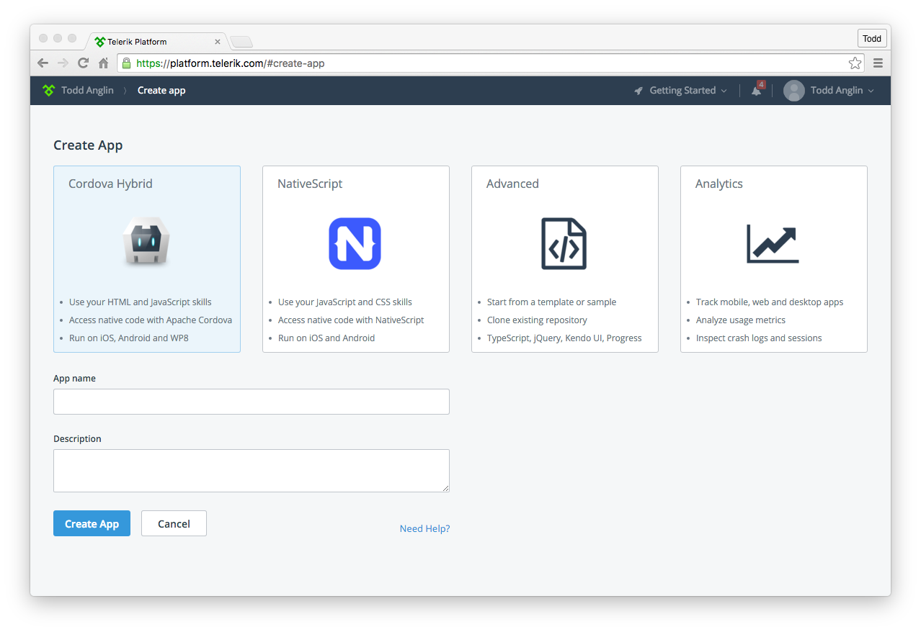
Telerik Platform
Use AppBuilder or Screen Builder
Subscription required
Build in the cloud (no local install required)
Easiest way to get started
Full support for {N} as of April
WHY: Richer tooling, Easier setup, Platform integrated
WHO: Less technical developers, Prefer Platform integrations, Windows developers targeting iOS

Slide 44
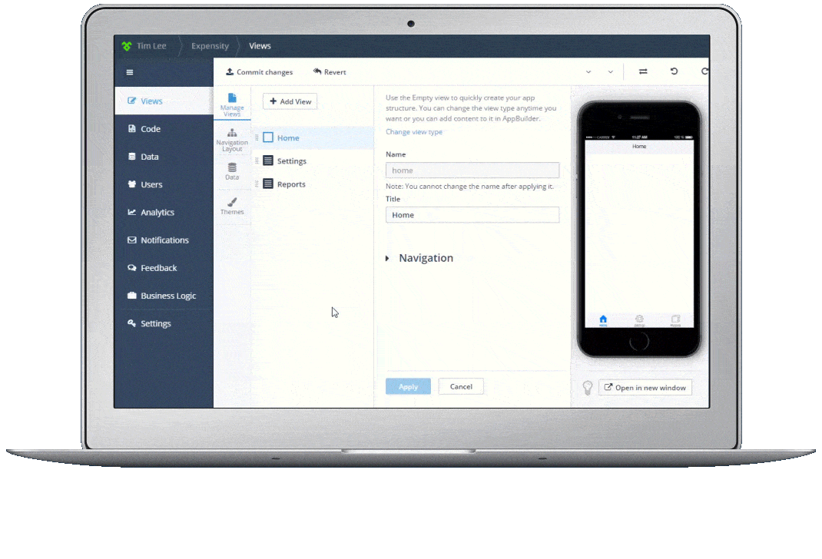
Telerik Platform
Powerful visual tooling, cloud builds and more for NativeScript app developers.

Slide 45
NativeScript CLI requirements
$ tns doctor
JDK, Apache Ant, Android SDK
Xcode, Xcode CLI tools, iOS SDK
https://github.com/nativescript/nativescript-cli#system-requirements

Slide 46
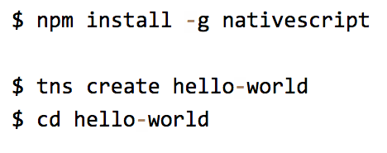
Starting a new project

Slide 47
Notes:
GET STARTED CLI

Slide 48
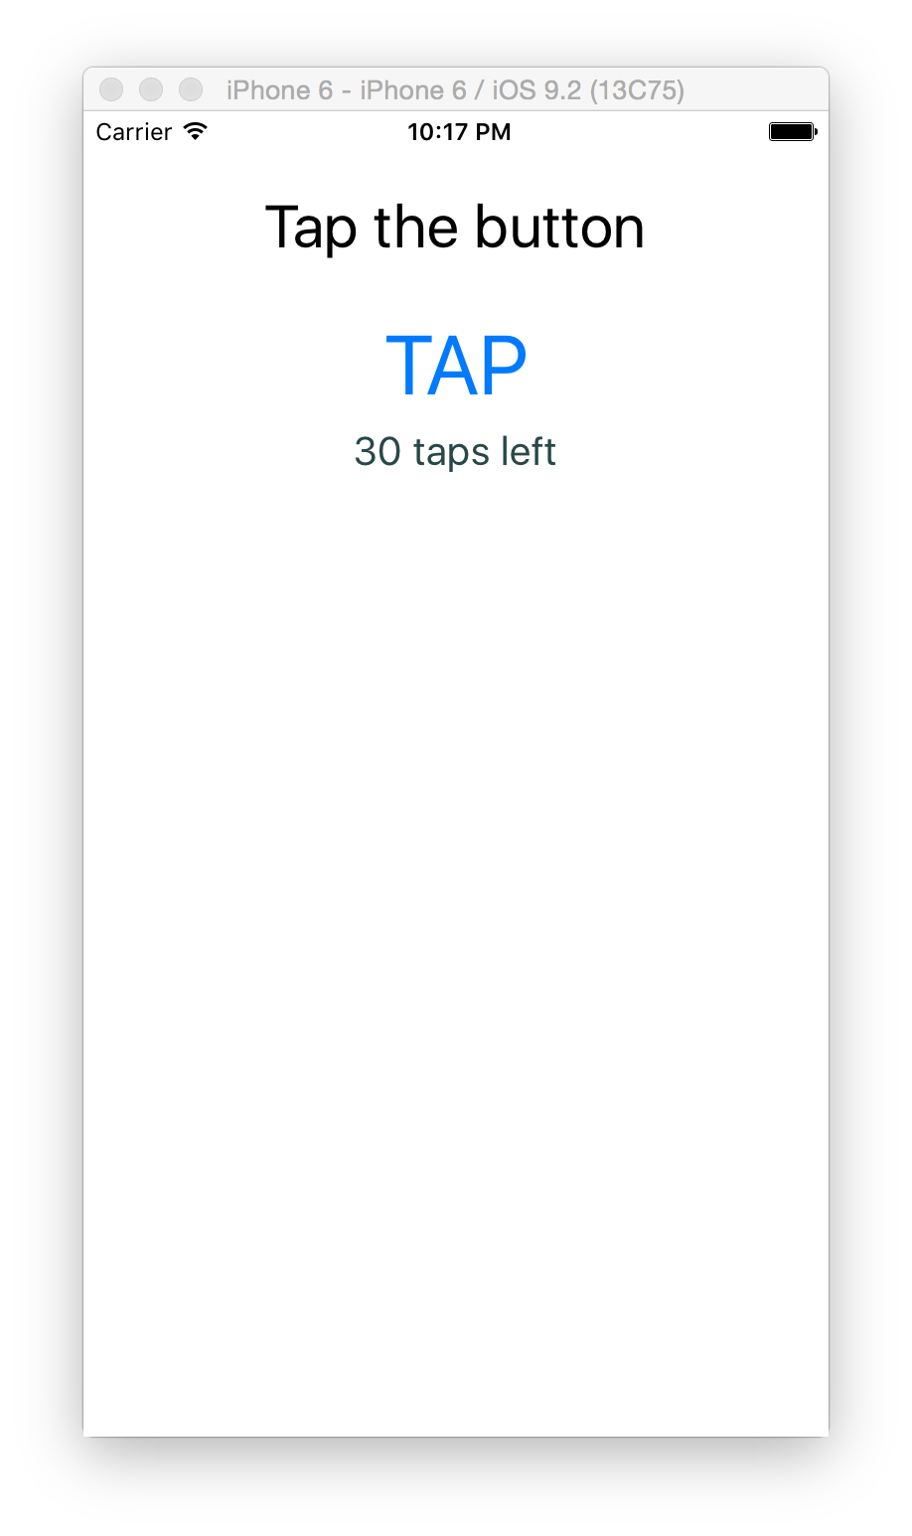
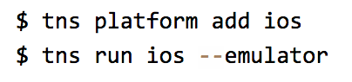
Running on iOS
or
$ tns emulate ios

Slide 49
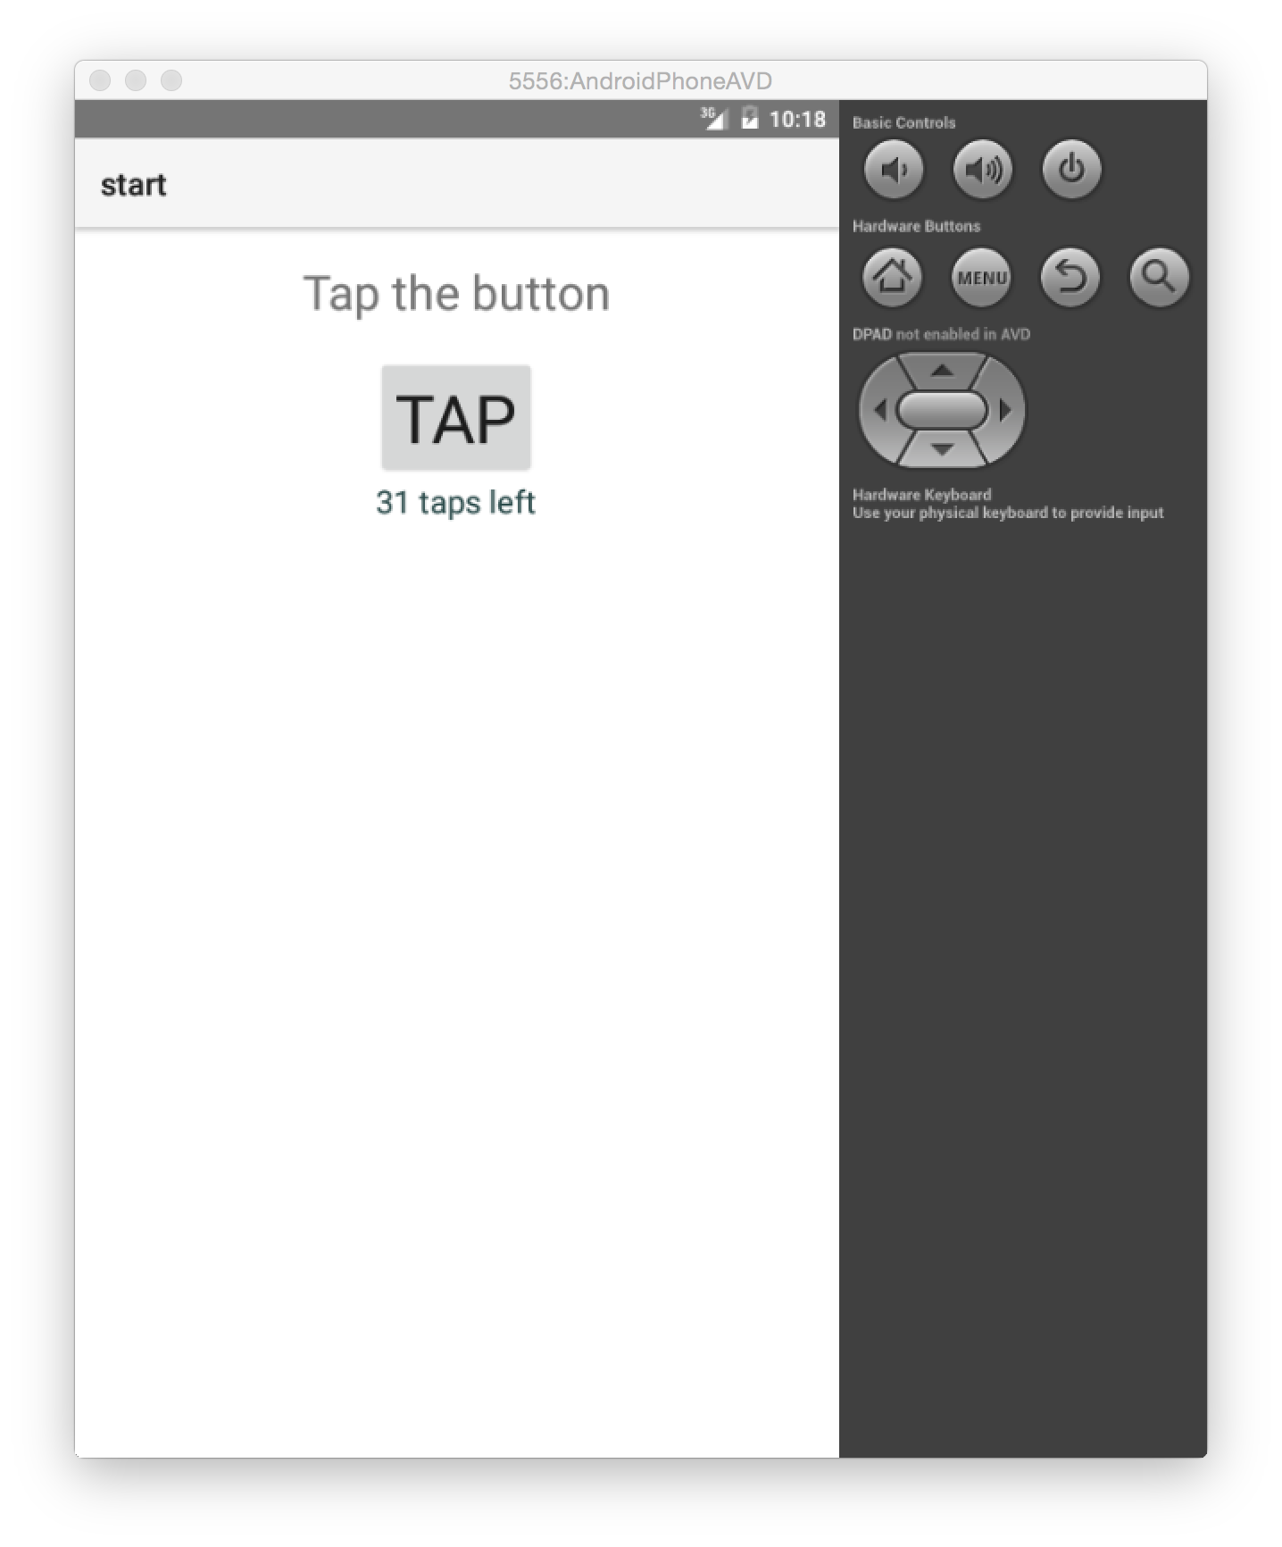
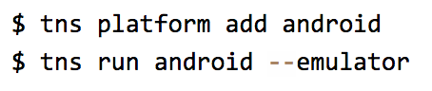
Running on Android
or
$ tns emulate android

Slide 50
A better Android emulator
Genymotion
Visual Studio Android Emulator

Slide 51
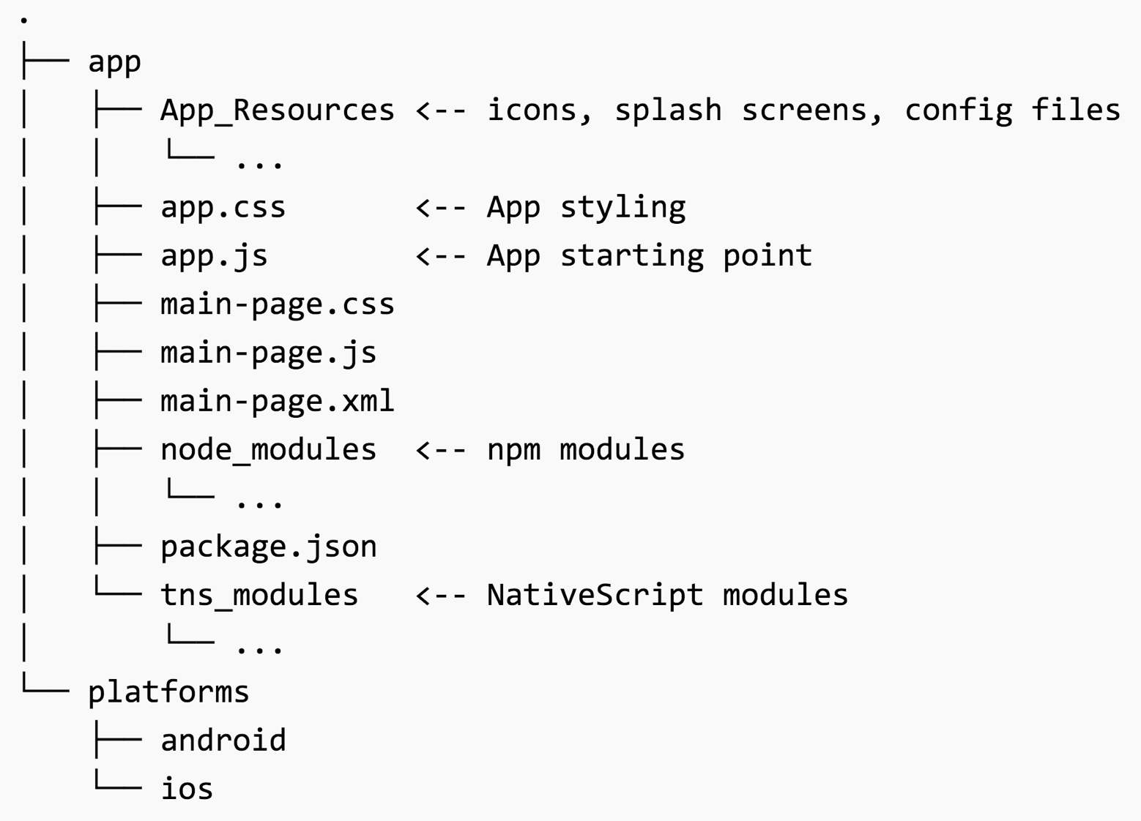

Slide 52
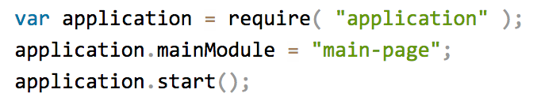
app.js

Slide 53
Defining Views

Slide 54
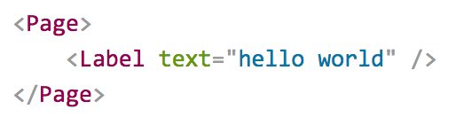
Pages
XML markup structure
Elements (e.g. <Page>, <Label>) are NativeScript modules

Slide 55
Layouts
UI Elements

Slide 56
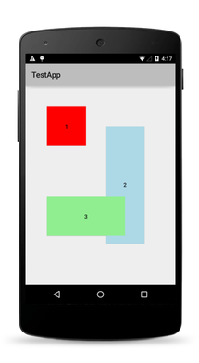
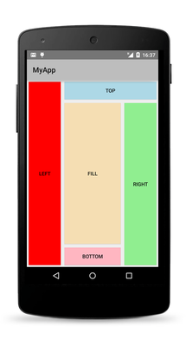
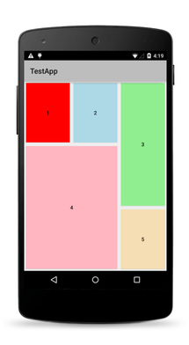
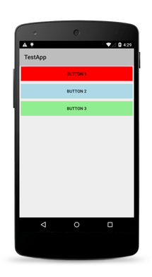
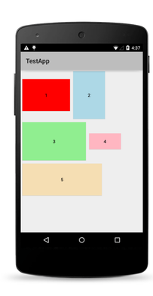
Layouts
Absolute
Dock
Grid
Stack
Wrap

Slide 57
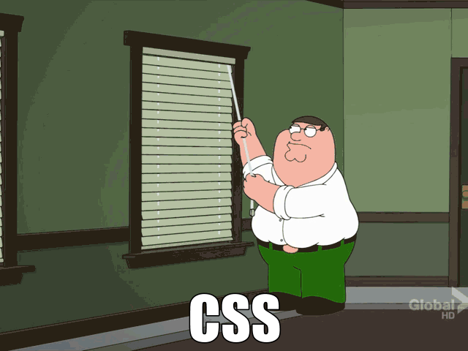

Slide 58
UI Widgets
Out-of-the-box
Button
Label
TextField
TextView
SearchBar
Switch
Slider
Progress
ActivityIndicator
Image
ListView
HtmlView
WebView
TabView
SegmentedBar
DatePicker
TimePicker
ListPicker
Dialogs
Native UI widgets means…
Native behavior
Native perf
Native accessibility
Parity with “native”

Slide 59
Native UI widgets
button
android.widget.Button
UIButton
{N} Module
Native API

Slide 60
Label
TextField
Repeater
SegmentedBar

Slide 61
StackLayout
GridLayout
Label
TextField
GridLayout

Slide 62
Notes:
UI WIDGETS

Slide 63
NativeScript LiveSync
$ tns livesync //For all connected devices/emulators
$ tns livesync android //Target specific platform
$ tns livesync ios --emulator
$ tns livesync ios --emulator --watch
Refresh app with latest changes to JS, CSS, XML
No re-build
Works with emulators AND device

Slide 64
Handling Events
XML
<button text="Click Me" tap="{{ onTap }}" ...
JS (ViewModel)
function pageViewModel() {
var viewModel;
viewModel.onTap = function() {
alert("You tapped me!");
}
return viewModel;
}
exports.pageViewModel = pageViewModel;
JS (View)
function onViewLoad(args) {
var page = args.object;
page.bindingContext = pageViewModel();
}
Create event handlers in JavaScript
Bind to event names

Slide 65
Handling Events
tap
label.on(gestures.GestureTypes.tap, function (args) {
console.log("Tap");
});
swipe
label.on(gestures.GestureTypes.swipe, function (args) {
console.log("Swipe Direction: " + args.direction);
});
Multiple events
label.on("tap, doubleTap, longPress", function (args) {
console.log("Event: " + args.eventName);
});
Tap
Double Tap
Long Press
Swipe
Pan
Pinch
Rotation
Touch

Slide 67
Telerik UI for NativeScript
Advanced, rich, native UI widgets for iOS and Android
UI for {N}
UI for {N} PRO
FREE
$199/$599 (with support)
Open source
Widgets: ListView, SlideDrawer
No support
Widgets: Chart, Calendar, DataForm
No support in entry pricing
UI for {N} can buy this version for support

Slide 68
Telerik UI for NativeScript
npm install nativescript-telerik-ui --save
Add powerful ListView, SlideDrawer to apps
Free native widgets
Support available with PRO license

Slide 69




Custom XML Components
<page xmlns:custom="modules/mymodule">
<custom:MyCustomControl />
</page>
Encapsulate reusable UI in components
JS only, OR
XML + CSS + JS
Add to pages with xmlns
modules
mymodule
MyCustomControl.js
MyCustomControl.css
MyCustomControl.xml
.XML

Slide 72
Targeting Views
Target based on:
screens size
minWH<X>, minW<X>, minH<X>
platform
ios, android, windows
Orientation
land, port
<file-name>[.<qualifier>]*.<extension>
styles.android.css
styles.ios.css
mypage.minWH600.xml
mypage.xml

Slide 73
TIP
Platform specific capabilities are always available
JavaScript: <view>.android or <view>.ios
Markup: <android></android> or <ios></ios>
Attributes: android:<attribute> or ios:<attribute>
Ex: <label android:class="…" ios:class="…" />
Write once by default.
Target specific platform capabilities when needed.

Slide 75
Basic Data Binding

Slide 76
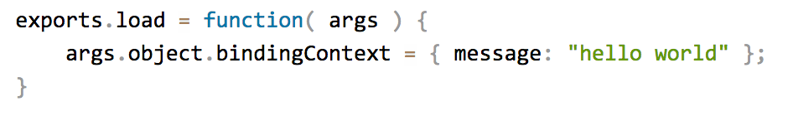
Data binding

Slide 77
{{ newTodo }}

Slide 79
Data binding improved

Slide 80
Data binding lists
<Page>
<StackLayout>
<ListView items="{{ items }}" height="200">
<ListView.itemTemplate>
<Label text="{{ $value }}" />
</ListView.itemTemplate>
</ListView>
</StackLayout>
</Page>
Bind to array or collection of data
Access named properties or $value
Access parent binding context with $parents
EX: OrderID in list of Order Details

Slide 81
{{ todos }}
{{ $value }}

Slide 83
Data binding expressions
Execute expressions during data binding to determine visual state
Source Property
Binding Expression
Static Expression
<TextField text="{{ sourceProperty, sourceProperty + ' some static text' }}" />
Ternary Operator
<TextField class="{{ isConditionTrue ? 'myClass true' : 'myClass false' }}" />
Converter
<TextField text="{{ testDate, testDate | dateConverter('DD.MM.YYYY') }}" />

Slide 84
Converters
var dateConverter = {
toView: function (value, format) {
var result = format;
var day = value.getDate();
...
//Return formatted model value
return result;
},
toModel: function (value, format) {
//Convert value from UI format to model format
return result;
}
}
Encapsulate more complex data binding formatting rules
Can be one-way or two-way
Add to page binding context OR global application context

Slide 85
Data binding expressions
Feature | Example
property access | obj1.obj2.prop1
array access | arrayVar[indexVar]
logical operators | !var1
unary operators | +var1, -var2
binary operators | var1 + var2
comparison operators | var1 > var2
logical comparison operators | var1>1 && var2>1.
ternary operator | var1 ? var2 : var3
grouping parenthesis | (a + b) * (c + d)
function calls | myFunc(var1, var2, ..., varN)
filters | expression \| filter1(param1, ...) | filter 2

Slide 86
{{ total, total +' items left' }}

Slide 88
Basic Styling with CSS

Slide 89
CSS
Convention:
app.css <-- Global styles
[viewName].css <-- View styles
[viewName].[platform].css

Slide 90
Supported Properties
color
background-color
background-image
background-repeat
background-position
background-size
border-color
border-width
border-radius
font
font-family
font-size
font-style
font-weight
text-align
text-decoration
text-transform
vertical-align
horizontal-align
margin
margin-top
margin-right
margin-bottom
margin-left
width
height
min-width
min-height
padding
padding-top
padding-right
padding-bottom
padding-left
visibility
opacity

Slide 91
Supported Selectors
Type
button { color: red; }
Class
.mybutton { color: green; }
ID
#myButton { color: #FFF; }

Slide 93
Custom Fonts
Use TTF or OTF fonts
Put fonts in: app > fonts
Use in CSS
.icon {
font-size: 30;
font-family: 'FontAwesome';
}

Slide 95
Sass & LESS
Use Sass or LESS syntax
Auto-compiled
$ tns install sass
OR
$tns install less

Slide 96
Pre-lunch Wrap-up

Slide 97


Slide 98
Bottom line
Access all native APIs with JavaScript
0-day support for new APIs
Use modules to increase cross-platform “write once”
Use CSS to style native UI
Use XML markup to define views
Use CLI (+ IDE integrations) or Telerik Platform to build and debug

Slide 99

Lunch Break
Resume @ 1PM

Slide 100
Workshop Agenda
Ante Meridiem (9AM to Noon)
Post Meridiem (1PM to 4PM)
Intro to NativeScript
NativeScript core concepts
“Hello World”
Defining Views
Basic data binding
Styling views with CSS
Extending with plugins
Debugging JavaScript
TypeScript, App Patterns and Angular
Navigating views
Adding animations

Slide 101


Slide 102
Adoption trends
Warm the brains-up after lunch

Slide 103
Adoption Goals (2016)
Goal for 2016: Grow NativeScript adoption by 15x
3x
5x
2x
Google Angular2 event (“ngConf”);
NativeScript Angular2 push begins
Aug
Sept
Oct
Nov
Dec
Jan
Feb
Mar
Apr
May
Jun
Jul
Aug
Sept
Oct
Nov
Dec
2016
Measured* active developers
(via NativeScript CLI)

Slide 104
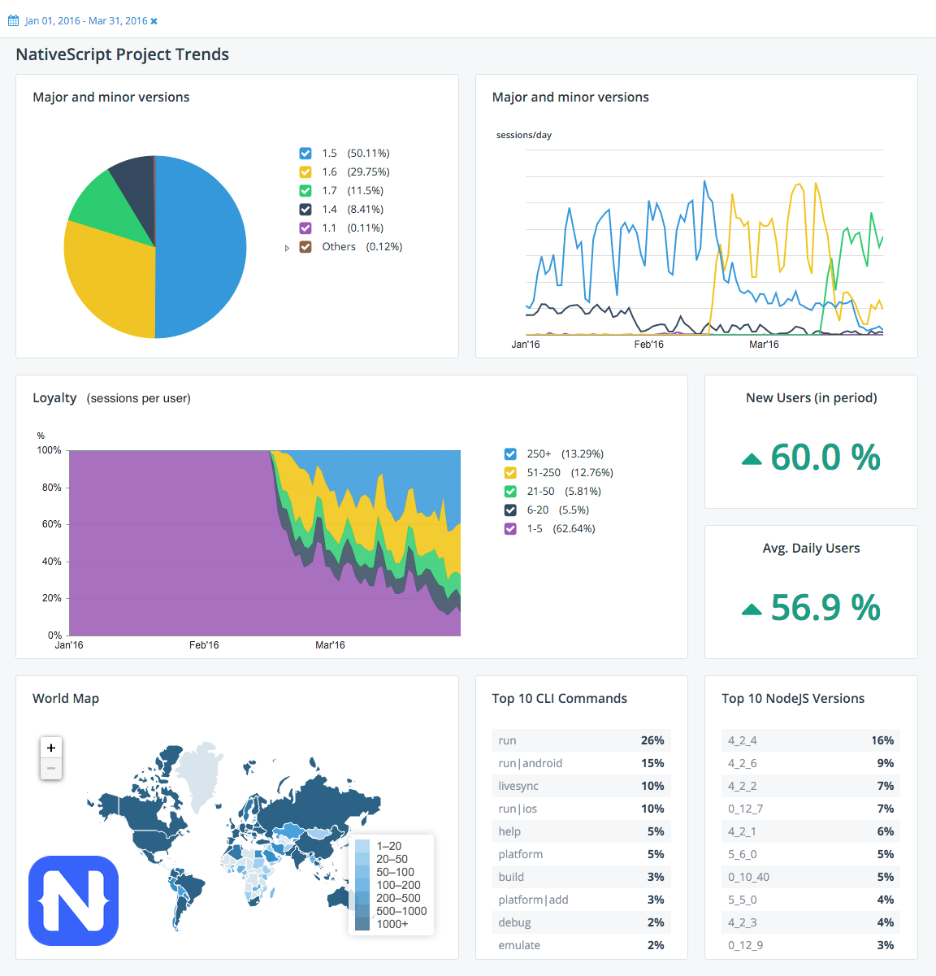
Active monthly CLI users doubled Aug to Dec ‘15
Doubled again Dec to Feb ‘16
On track to double again by end of April
60% increase in new users since January

Slide 105
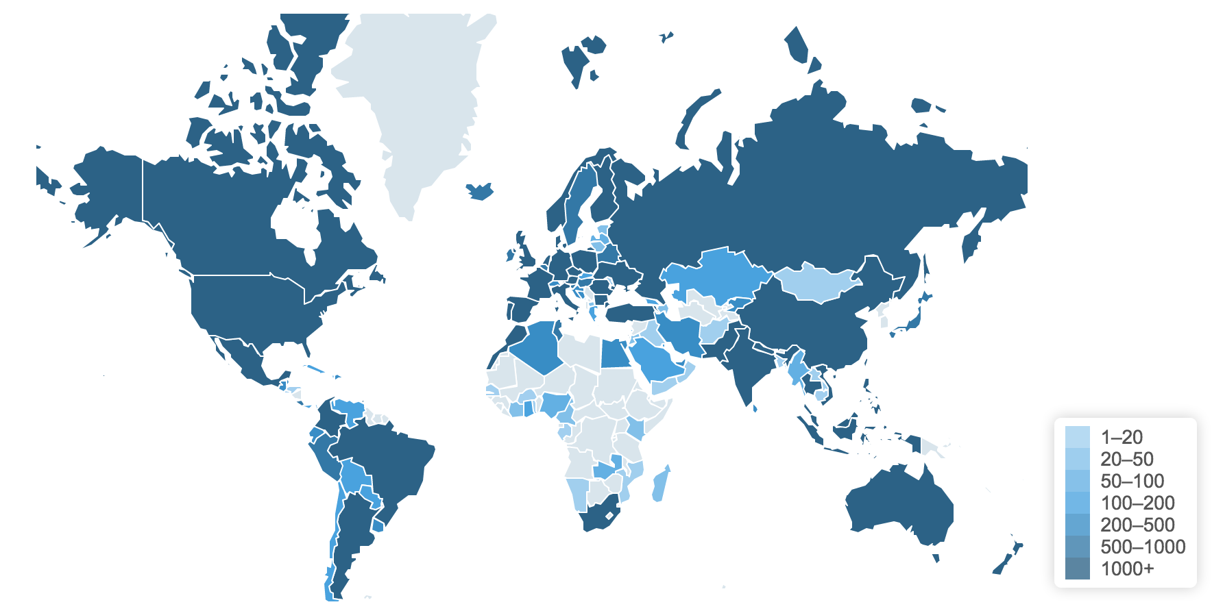

Slide 106
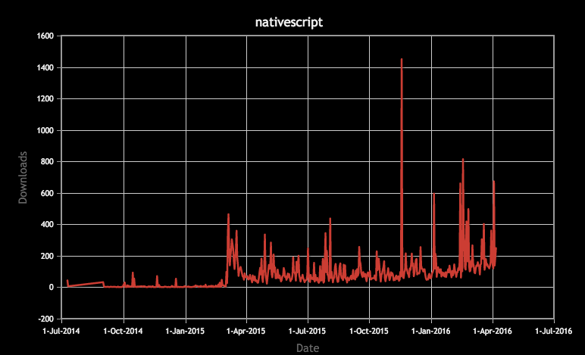
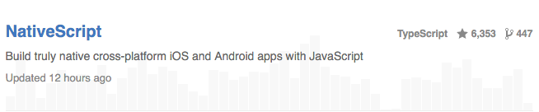
npm & GitHub

Slide 107
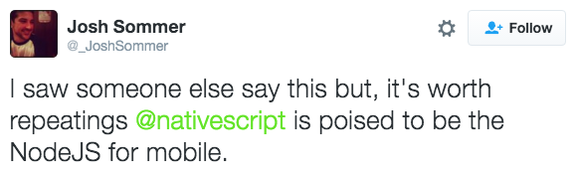
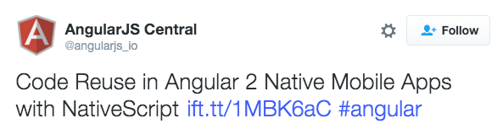
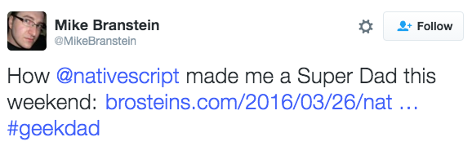
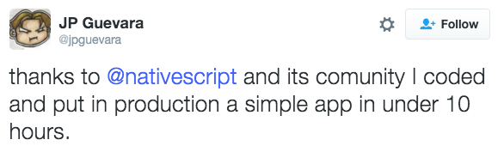
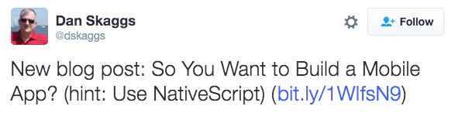
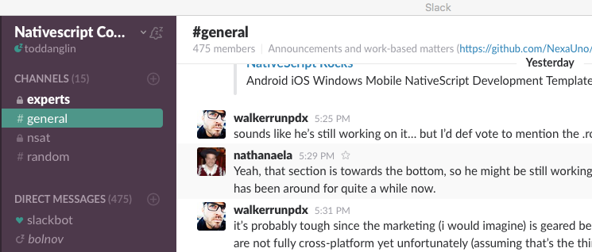
Developer Comments

Slide 108

Join the growing NativeScript community on Slack
bit.ly/nativescript-slack

Slide 109
Integrations & Ecosystem

Slide 110

Plugin Ecosystem

Slide 111

Plugin Ecosystem
Reusable libraries
IDEs
Verified Plugins

Slide 113


Angular & TypeScript
Created by Microsoft
Open source
Popular compiler for JavaScript that adds powerful language features
Used to create Angular 2 and {N}
Created by Google
Open source
Popular JavaScript framework for building complex web apps
“Angular 2” ships in May

Slide 114


Slide 115


Slide 116

ngConf
Fast facts:
May 4th to 6th in Salt Lake City
Largest Angular developer event in US (~1300 developers)

Slide 117

Modulus
Sachse Construction
Day Care
This or That!
PocketSmith

Slide 118
“With NativeScript it became apparent quickly that we would no longer have a need for iOS and Android specialists—our Microsoft .NET team became fully functional—fast.”
Allan Kreyer, CIM Mobility Founder

Slide 119
TypeScript, App Patterns and Angular

Slide 120



Choice in Architecture
Javascript
Write your application using plain Javascript
TypeScript
Use TypeScript to get Object Oriented features and compile time error checking
Angular
Use Angular to architect application. Reuse almost all code between web and mobile

Slide 121

Notes:
TypeScript provides static language features which are imperative when you are working with a large API surface, such as the .NET, CocoaTouch (iOS) and Android SDKs.
This is one of our most viewed articles on TDN
NativeScript is built with TypeScript
Angular 2 is built with TypeScript
Anders Heilsberg calls it “the most fun I’ve ever had”

Slide 122

Notes:
TypeScript is REALLY popular
Why is it so popular? And why should you use it?
It is opt-in
It’s just JavaScript
It IS ES6
If you’re writing TypeScript, you are writing ES6
The it enables the design time tooling that JavaScript has been missing since day one
It is imperative when working with enormous API design surfaces, such as .NET, iOS and Android

Slide 123
Adding TypeScript
tns install typescript
Notes:
That’s it. Nothing else. NativeScript will add the proper .tsconfig file and npm hooks to do all the builds.

Slide 125
Debugging

Slide 126
“If debugging is the process of removing software bugs, then programming must be the process of putting them in.”
- Edsger Dijkstra

Slide 127
No DOM Quiz
Can you use the window object?
window.open(“http://theuselessweb.com”);
Can you select elements with jQuery?
$(“#someId”).hide();
Can you use console.log?
Console.log(“What do you get when you cross a joke
with a rhetorical question?”);

Slide 128
Debugging Strategies
Debug by alert (no really)
Debug by console.log
Debug by Developer Tools
Debug by IDE
Visual Studio
Visual Studio Code

Slide 129

Debug By Alert

Slide 130
“There is no DOM in NativeScript, so there is no alert, so alerts are totally legit.”
- Edsger Dijkstra

Slide 132
Common App Patterns
Services
An object that is responsible for getting and setting data
Models
Super dumb objects that define the structure of the data
ViewModels
AKA Controllers. Controls the state of the UI and performs when changes are made to model objects.

Slide 133
Notes:
Probably groceries. Show the pattern. That is all.

Slide 134
Angular 2
Notes:
Why Angular 2? Why not just JavaScript?
Built with TypeScript
Provides a pattern for application structure
Fundamental concepts such as DI – yes, even in JavaScript you need DI
Most importantly – code sharing with the web

Slide 135
Data binding with Angular
{{ }} – still works!
You can still use {N}'s standard binding…
But you can do it even better.
[] – Property binding
One way.
Like array notation in JavaScript. One way
() – Event Binding
When you want to bind to an event.
Two Way – [(ngModel)]
Almost always used with ngModel

Slide 136
Extra Angular Goodies
Dependency Injection
Routing
Components
Pipes
Services
FAST

Slide 137
Angular Roadmap
ngConf
Angular 2 RC
{N} ng beta
AngularConnect
(London)
Angular 2 (final)
{N} ng (final)
Microsoft BUILD
Jan
Feb
Mar
Apr
May
Jun
Jul
Aug
Sept
Oct
Nov
Dec

Slide 138
Navigating Views

Slide 139
Basics
"topmost frame"
Topmost frame is root-level container
Facilitates navigation between views
var frameModule = require("ui/frame");
var topmost = frameModule.topmost();

Slide 140
Navigating with "topmost"
1. By File Name
topmost.navigate("details-page");
2. With Navigation Entry
var navigationEntry = {
moduleName: "details-page",
context: {info: "something"},
animated: false
};
topmost.navigate(navigationEntry);
3. Dynamically with Function
var factoryFunc = function () {
var page = new pagesModule.Page();
page.content = ...
return page;
};
topmost.navigate(factoryFunc);
Always navigating with topmost.navigate()
Pass context to views and parse in onNavigatedTo event
Go back with:
topmost.goBack();

Slide 142
View transitions
curl (same as curlUp) (iOS only)
curlUp (iOS only)
curlDown (iOS only)
explode (Android Lollipop and later)
fade
flip (same as flipRight)
flipRight
flipLeft
slide (same as slideLeft)
slideLeft
slideRight
slideTop
slideBottom
var navigationEntry = {
moduleName: "main-page",
animated: true,
transition: {
name: "slide",
duration: 380,
curve: "easeIn" }
};
topmost.navigate(navigationEntry);
Different transitions can be set for iOS and Android

Slide 143
Using Telerik Platform
Cloud-based tooling for NativeScript

Slide 145
Why?
Cloud based, zero setup
Build for iOS from Windows
Deploy to device without provisioning profiles
Manage app properties faster

Slide 146


AppBuilder

Slide 147

Screen Builder

Slide 148

Companion App

Slide 150
Animations

Slide 151


Slide 152


Slide 153
Animation basics
Configure:
target (UI element)
duration (in ms)
delay
iterations
curve
Animate:
opacity
backgroundColor
translateX and translateY
scaleX and scaleY
rotate

Slide 154

Simple animation
var view = page.getViewById("myLabel");
view.animate({
translate: { x: 0, y: 100},
duration: 1000,
curve: enums.AnimationCurve.easeIn
});
Animations can be chained together
Multiple properties and elements can be animated
Return a promise that can be canceled

Slide 156
Roadmap 2016

Slide 157
Roadmap Milestones
{N} in Telerik Platform
Angular 2 beta support
Telerik UI for {N} release
{N} in Screen Builder
Major UI improvements
Official VS Code integration
Mobile bundle for {N}
More premium UI widgets
Android 7 support
Perf optimizations
Win 10
support preview
Official Angular 2 support
Design templates
Angular starter kits
iOS 10 support
Win 10 support
1.6
1.7
2.0
2.1
2.2
2.3
2.4
Jan
Feb
Mar
Apr
May
Jun
Jul
Aug
Sept
Oct
Nov
Dec

Slide 158
NativeScript is…
an open source framework for building truly native mobile apps with JavaScript. Use web skills, like Angular and CSS, and get native UI and performance on iOS and Android.

Slide 159
NativeScript
delivers the promises of “hybrid.”

